Slide 1
Typing Game Sample Output
Note: The word next to “Type Here” is the word the user types after seeing the above board, so in the next instance of the board the word should disappear.

Slide 2
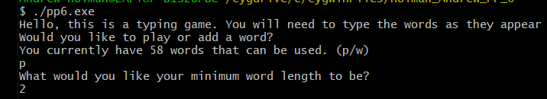
Starting Message

Slide 3
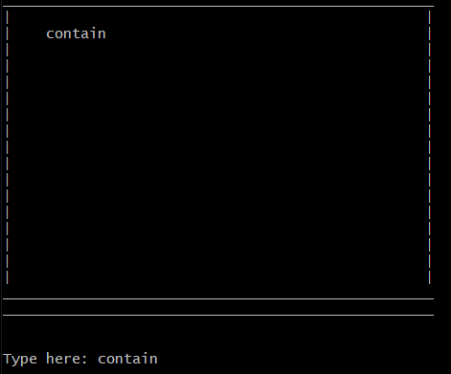
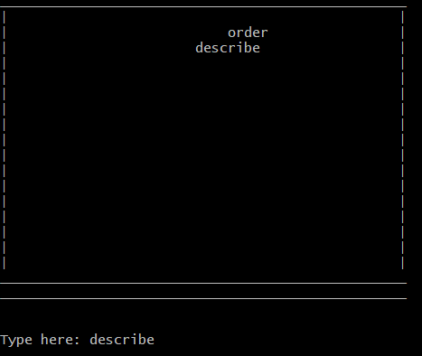
Initial Board with Starting Word

Slide 4
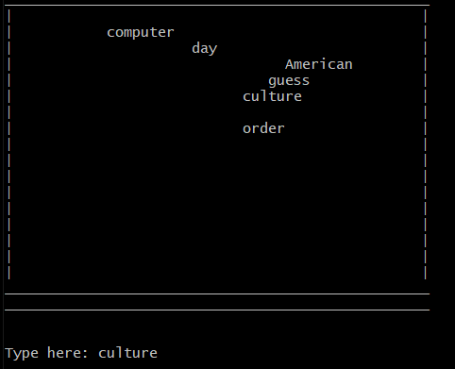
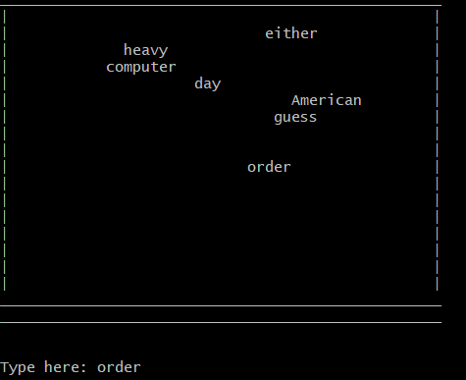
Notice “culture” disappears despite “order” being lower

Slide 5
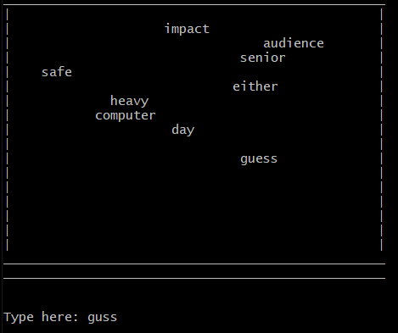
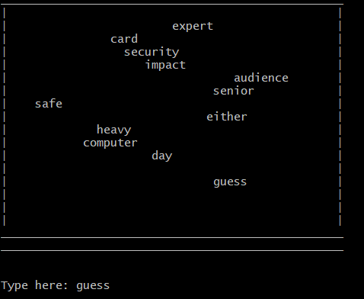
Notice incorrect spelling of “guess” doesn’t remove it from the board

Slide 6
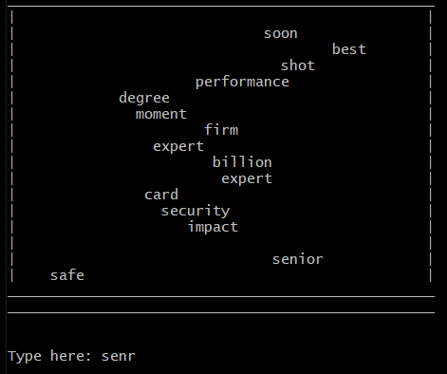
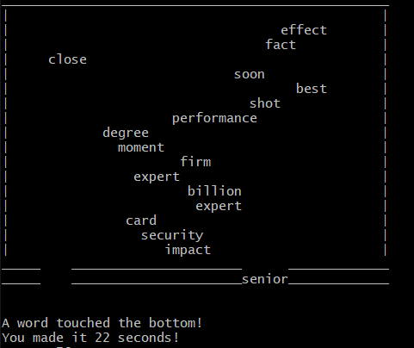
On a loss, the word touches the bottom of the board and it prints out the time that the player lasted.

Slide 7
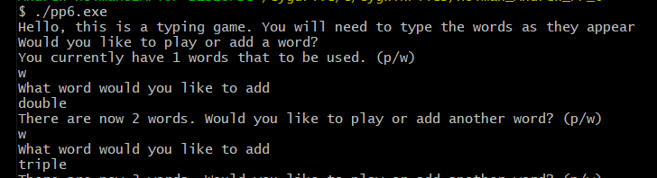
Starting Message with Adding Words

Slide 8
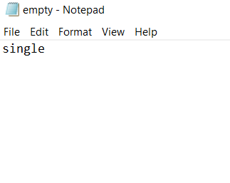
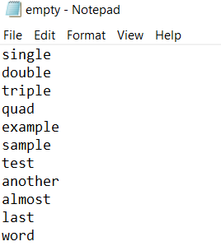
Text File Before and After

Slide 9
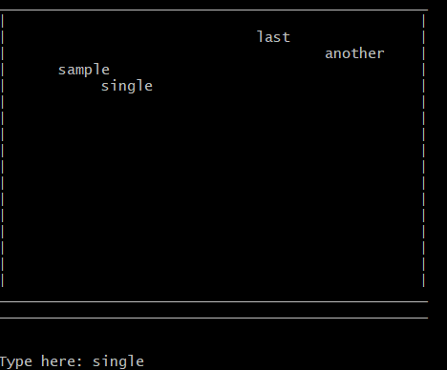
Example of board with our new words

